Slide 1
A Plan for Transformation: Integrity Process
Mark A. Bartkoski, P.E.
143rd SME Meeting & Exhibit
February 26, 2014
Salt Lake City, Utah

Slide 2
Overview
Leadership Philosophy Transformation
Motivation for Transformation
Integrity Process
Foundation
Process
Outcome
Integrity Process Pillars
Integrity Process Implementation
Integrity Process Development Resources
Conclusion

Slide 3
Transformation must happen in:
ME
Asset Allocation
Personnel Placement
Operating Style
Reserves
Equipment
Site Facilities
Support Infrastructures
Skill-set
Aptitude
Pairings
Character
Based on ‘earning security’ together
Lead by Servant Leadership
Support
May achieve Good

Slide 4
Transformation must happen in:
ME
WE
Asset Allocation
Personnel Placement
Operating Style
Based on ‘earning security’ together
Lead by Servant Leadership
Support
May achieve Good
Potential to be Great
ME

Slide 5
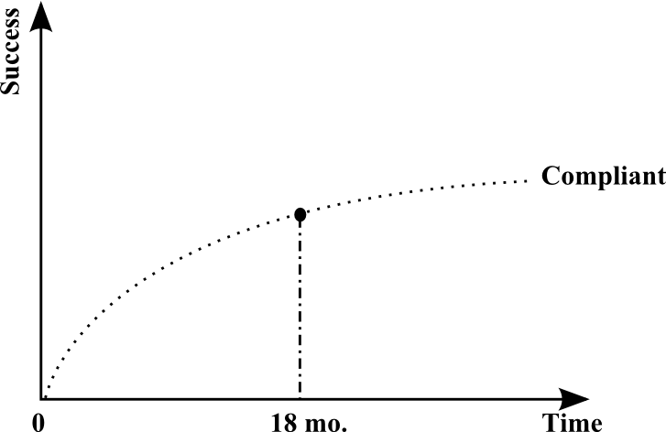
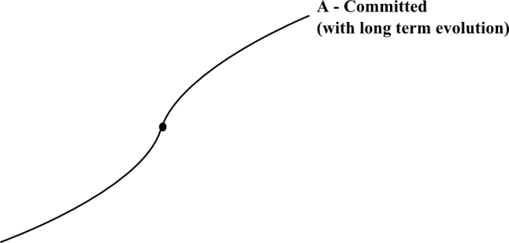
Transformation must happen in:
Asset Allocation
Personnel Placement
Operating Style
Motivation for Transformation
Committed vs. Compliant
Why change (explain, team communication)
How to address

Slide 6
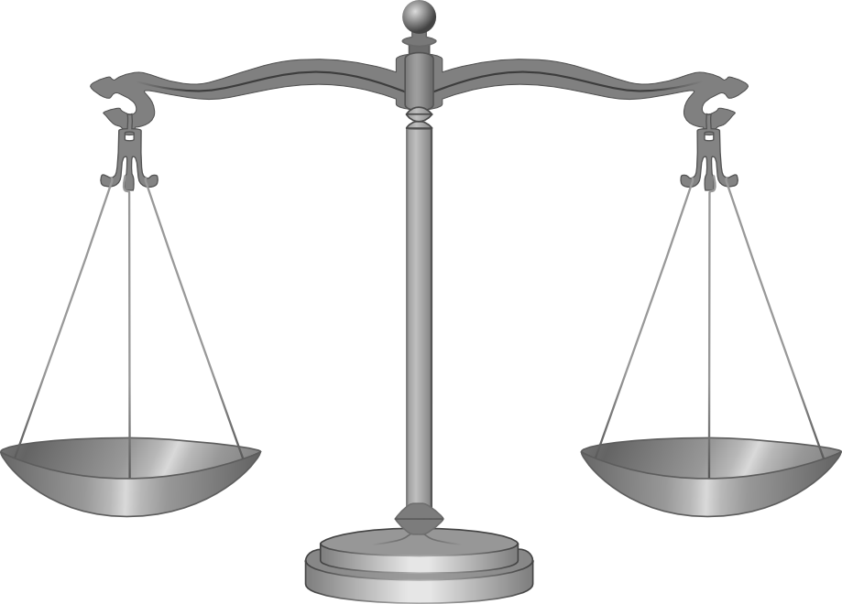
Transformation must happen in:
Asset Allocation
Personnel Placement
Operating Style
Motivation for Transformation
Business Operating Plan
Safety
Production
Unite under a common Mission Statement
Vision – Security is an earned position
Develop a plan
Integrity Process

Slide 7
Integrity Process: The Building of Integrity
Example:
Safety
Prevention*
Teamwork
Mutual Respect
Communication*
Training*
Accountability
Continuous Process Improvement
Reverence
Values
Foundation
Mission Statement

Slide 8
Integrity Process: Process Pillars
Process Pillars are:
A collection of management tools, techniques, and systems
Developed after a balance of values is achieved

Slide 9
Integrity Process
The MVP Plan
Builds Security
SECURITY
Owners, Mgt., Workforce, Community
Train and Educate:
Cost of Loss*
Engage Employees
Function Preventatively
Guard Against Pitfalls*
Pillar
I
Pillar
II
Pillar
III
Process
Values
Foundation
Mission Statement

Slide 10
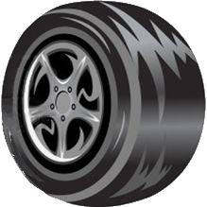
Integrity Process: Process Pillars
Process Pillars are:
A collection of management tools, techniques, and systems
Developed after a balance of values is achieved
Based on Principles of Process - GRM
GATHER
INFO
Gather
Refine
Monitor
MONITOR
RESULTS
REFINE
PROCESS

Slide 11
Integrity Process: Process Pillar I
SECURITY
Pillar
I
Pillar
II
Pillar
III
Values
Mission Statement

Slide 12
Integrity Process: Process Pillar I
Gathering Tools
(information)
EI
Employee Inspection – every employee will turn in a daily checklist and comment note on their area.
Refining Procedures
(process)
WR
Work Request – repairs or preventative measure are prioritized, responsibilities assigned, completion checked, and progress tracked.
Monitoring Systems
BL
Backlogs – outstanding WR are monitored for completion, time to finish, and repeating trends.
CL
Cost of Loss – failed items or losses are evaluated in total economic terms and publicized.

Slide 13
Integrity Process: Process Pillar II
SECURITY
Pillar
I
Pillar
II
Pillar
III
Values
Mission Statement

Slide 14
Integrity Process: Process Pillar II
Gathering Tools
(information)
ES
Efficiency Survey – an on-shift interview with an employee probing for input, ideas, or suggestions to improve safety and productivity.
PS
Process Study – a data gathering and motion study of each job and its effect on flow.
AT
Action Team – a group of employees selected to work on a specific issue.
Refining Procedures
(process)
BP
Best Practice – the agreed upon most efficient way to do a job and/or process.
MI
Major Initiatives – a highlighted improvement project.
WR
Work Request – repairs or preventative measure are prioritized, responsibilities assigned, completion checked, and progress tracked.
Monitoring Systems
EA
Efficiency Audits – an on-shift study (motion, input, and observation) on the compliance to BP’s (job and process).
ROI
Return on Investment – the calculated result of an improvement project.
BL
Backlogs – outstanding WR projects are monitored for completion and time to finish.

Slide 15
Integrity Process: Process Pillar III
SECURITY
Pillar
I
Pillar
II
Pillar
III
Values
Mission Statement

Slide 16
Integrity Process: Process Pillar III
Gathering Tools
(information)
SR
Shift Report – any report that conveys production/output and/or downtime information.
LI
Loss Intervention – a study and recommendations pertaining to a loss (injury, violation, downtime, rework, or waste) or near miss.
RA
Risk Assessment – a study and recommendations pertaining to a potential loss.
Refining Procedures
(process)
FM
Failure Maintenance – repair of the damaged item.
PM
Preventative Maintenance – proactive action to eliminate or push out a loss.
WR
Work Request – repairs or preventative measure are prioritized, responsibilities assigned, completion checked, and progress tracked.
Monitoring Systems
DT
Downtime – delay caused by a loss.
PI
Performance Indicators – performance measurement that tracks progress.
OC
Operating Cost – cost calculated per each piece of equipment, it is the cost of the downtime and cost of repair parts/supplies and cost of maintenance repair time.
BL
Backlogs – outstanding WR projects are monitored for completion and time to finish.

Slide 17
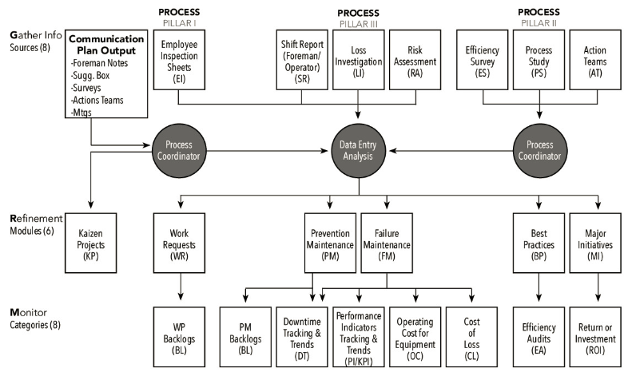
Integrity Process: Flow Chart

Slide 18
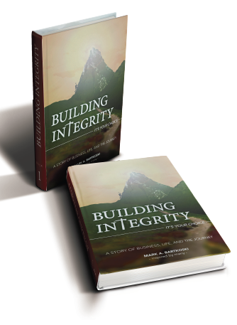
Integrity Process Development Resources:
Building Integrity has been written. It is a fictional example of a corporate rebuild using Integrity Process. The book also offers business/training reference material via 40 Appendices.
Refining Integrity is being written now. Release is expected in 2015. The second book will dive deeper into the value training and process techniques.
Book information and ordering instructions can be found on
www.IntegrityDevelopment.us

Slide 19
Integrity Process Development Resources:
Objective:
To introduce an alternative operating style. It is one of focused vision, foundational values, and centered around Integrity Process. It is a philosophy and practice team empowerment that undergirds the common goal of “earning security.” A win-win from the board room to the employee’s homes. Applicable in any industry challenged to optimize process through their people.
Release Date: March 13, 2014
Available At: www.IntegrityDevelopment.us

Slide 20
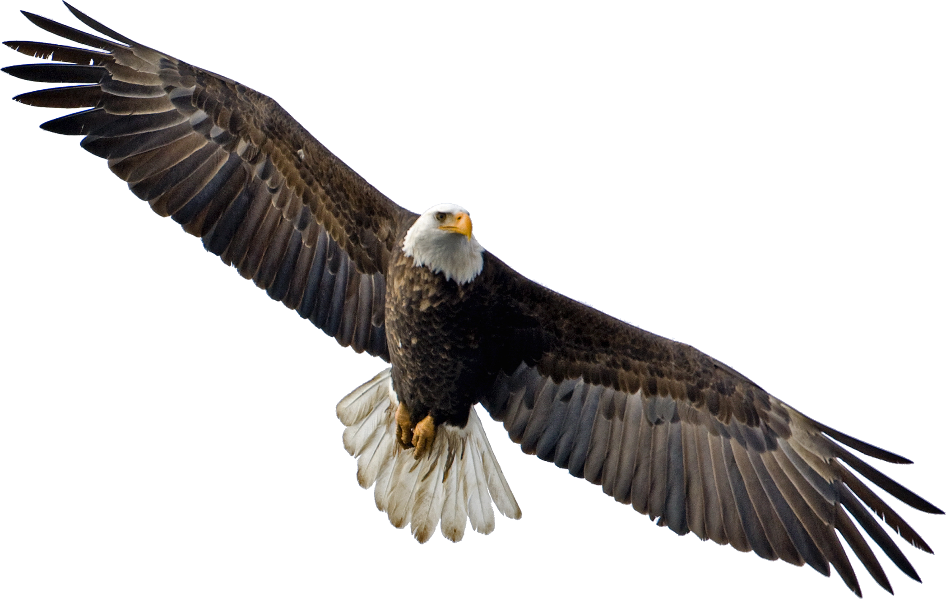
Conclusion
Integrity Process is a Business Plan Model that is intertwined with the strengthening of ones character, thus the motto:
“Integrity of Character,
builds Integrity of Process”

Slide 21
Thank You

