Slide 1
Developing a Dust Reduction Initiative
“In God We Trust”
www.IntegrityDevelopment.us

Slide 2
Mine Atmosphere Make-up
a) Clean air
b) Airborne irritants: +10 microns, nose hairs/exhale expelled
c) Respirable particles: -10 microns, lungs retain them at least
temporarily, size fraction of 1 to 3 microns causes most of the
long term damage
Note: Visible dust is greater than 10 microns,
thus the health damaging respirable dust can
be termed invisible. We should consider it an
‘invisible poison’ of which harms us and our
people everyday we are exposed. It is a
progressive disease.

Slide 3
Mine Dust Facts:
1) PNEUMOCONIOS is a disease made-up of:
- Silicosis (silica particle damage and build-up).
- Black Lung (coal dust accumulation).
2) The disease results in reduced lung capacity, impaired
breathing, and restricted circulatory systems. It increases the
chances for heart attacks, COPD, pneumonia, tuberculosis, lung
collapse, and cancer.
Do we realize our bodies are damaged every time we are exposed to respirable dust?

Slide 4
Mine Dust Facts:
3) The true total negative affects of PNEUMOCONIOS are
considered to be far greater than documentation shows.
4) NIOSH estimates more than 76,000 miners have died since 1968
from PNEUMOCONIOS. That’s over 1,500 people/year.
Doesn’t this define a CRISIS?

Slide 5
Mine Dust Facts:
5) Government records show claims paid since 1968,
exceed $45 billion.
6) Many companies report the average Federal Black Lung claim is
settled at over $200k.
Who is accepting the accountability or do we just blame the mining process?

Slide 6
Mine Dust Facts:
7) Recent increases in mining productivity rates in many cases also increases dust
generation.
8) Silica particles have a far larger negative medical affect than coal dust.
9) Mining conditions, which cut and/or drill sandstone or high silica rock, liberate more
silica in the mining process. These conditions have been more common in recent
years.
10) Increased rock dusting requirements have had a significantly escalated affect on silica
levels.
11) Many companies have seen strong increases in intake air ambient levels of rock dust.
12) ‘Fine’ rock dust types are considered better with respect to explosion dampening,
but increases exacerbate respirable silica problems.
13) Increased quantities of silica particles in suspension are
building-up to a potential ‘perfect storm.’
Is not addressing the growing contributing factors working?

Slide 7
Does dust reduction warrant our high priority?
1) For our people and our personal health? (effects are not seen immediately)
2) Achieving lower medical and claims costs associated with less respirable dust
ingestion. (hard to quantify and who is responsible)
3) To reduce the explosive conditions in the mines from airborne coal dust.
4) For the reduction of agency fines and operating limitations from respirable dust
violation compliance. Recent circumstantial changes:
a) new lower limits
- normal (1.5 milligram/m³) - silica restricted
- ‘part 90’ (0.5 milligram/m³)
b) specific position requirements
- longwaller - roof bolting - belt transfers - rock duster - rock cutting - haulage (blowing vent.)
- miner operator - crushing - ?
c) cost of and the frequency of excursions
d) enhancement alternatives to be provided
e) cut depth limitations
f) downwind limitations
- CM and RB and Shear/Plow - All personnel (?)

Slide 8
Facets of a Complete Dust Reduction Program:
1) Generation Sources addressed
- Bit Type/Sharpness - Rock Dust Type
- Airflow (Direction/Rate) - Cutting System Specifications
- Rock Duster Types/Application - Coal/Rock Characteristics
- Belt Transfer Design - Road Maintenance
- Clothes Cleanliness - Transportation Type
2) Extraction Systems maximized
- Scrubbers/Filters - Electrostatic Affects
- Clothes Vacuum - Water Sprays/Curtains
- Wetting Agents
3) Isolation Techniques utilized
- Ventilated Enclosures - Equipment Cleaning
- Airflow (Volume, Exhaust/Blowing) - Rock Dust Handling
- Miner Cut Sequence - Rock Dusting Timing
- Body Position - Water Sprays/Wet-heads
• Normal, Unusual, Unexpected Situation - Shrouds

Slide 9
Facets of a Complete Dust Reduction Program:
4) Personal Factors considered
- Dust Fact Education/Prevent Training - Shift Lengths
- Individual Work Habits - Smoking
- Personal Accountability - Work History
- Individual Body Reaction - Future Exposure Build-up
5) Respirator use
- Type Effectiveness - When Required
- Filter Capacity/Particle Size - Respirator Credits/Fines Relief
- Wearability Compliance - Future Agency Exposure Position
- Voluntary Investment in Employee’s Health

Slide 10
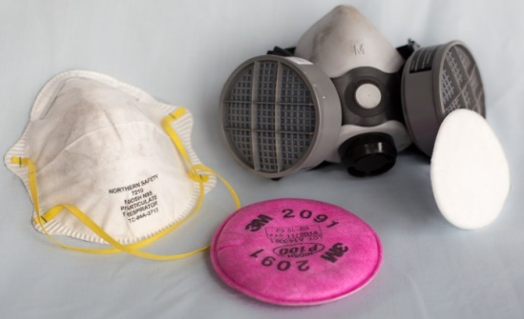
Respirator Types:
1) Negative Pressure Masks
+ Inexpensive - Seal Leakage (Face Struct./Hair, Movement)
+ Low Maintenance • Face mask dust tracks indicate exposure
± Design Effectiveness - Fit Testing
± Unit Size/Weight - Filter Capacity and Porosity
- Talking Restrictive
- Operator Comfort
• Lung Restrictive (fatigue) • Hot
• Potential Headaches • Strap Irritation
- Psychological
• ‘Not Macho’ • PPE is considered
• Forced to change ‘questionably worth it’
2) Positive Pressure Systems
+ Effective - Bulkier
+ Cooling Effect - Higher Maintenance
+ Wearability - Expensive (payback is very quick)
- Psychological
Is Eradicating the affects of
Respirable Dust worth the cost to change?

Slide 11
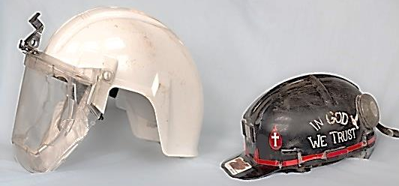
Positive Pressure Systems:
The Purifier (pat. pending) Airstream
Comment Rating Comment
1) Helmet Size personal choice A D large, +2” higher, 6” longer
2) Helmet Weight personal choice A C 3.5lbs, neck fatigue
3) Shield Visibility no shield, positive air sweep A C scratches, water sprays, fogging
4) Vision open A D peripheral/top-side restrictive
5) Eye Glasses Fit A C depends on glasses shape
6) Fan Cord Nuisance 18” long A C 42” long
7) Maintenance – System B B
- Rotating Shield A C
8) Reliability simple A C numerous parts
9) Fan Noise on lower back A C 5” from the ear
10) Vest Convenience (optional) pockets, safety vis color A -
11) Unit Transportation to Site easily worn B D usually carried
12) Commun. System Adaptive A D
13) Filtered Air Supplied more than needed (+2x) A A more than needed (+2x)
14) Dual Filter System A A
15) Filter Porosity Hepa, 99.7% on +0.1 micron A A Hepa, 99.7% on +0.1 micron
16) Filter Capacity self cleaning (vert), +100in² A B + 100in²
17) Seal Leakage/Fit Test Issues positive mask pressure A A positive mask pressure
18) Initial Cost* $850** (+40% savings) C D $1,450
* Priced without battery/charger
** If specific Airstream parts are traded in, a substantial credit will be given.

Slide 12
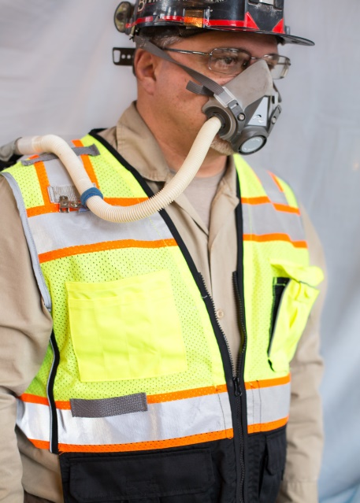
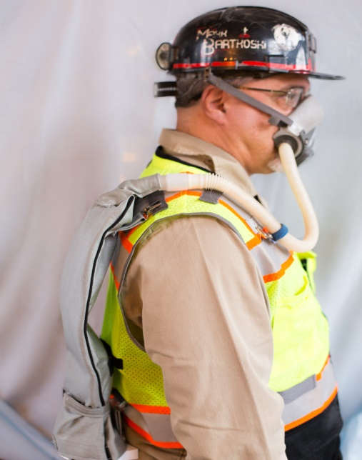
The Purifier (pat. pending)
Hard Hat
Parts
●
1) Face Mask – fits over nose and extends
to chin line. It rests on the bridge of the
nose. The face piece is open on the
bottom thus keeping positive blowing
filtered air to the nose/mouth and yet
offering some filtered air storage.
2) Hat Clips (2) – optional headband avail.
3) Tubing Clip for Vest
4) Flex Tubing – ¾” diameter
5) Bag and Clips
6) Secondary Filter – 4” wide x 2” thick x
13” long, replaceable.
7) Filter Strap
8) Filter Spreader
9) Pump and Power Cord* - 5” wide x 3”
deep x 6” high, fan type.
10) Primary Filter - washable
11) Battery* - belt wearable, rechargeable
or cap light with PTO adapter.
12) Battery Pouch
13) Vest with Mask Bag (or suspenders)
14) Battery Charger
15) Carry Bag
16) Airflow Test Disc
* Electrical components are MSHA approved for underground use.
4
2
3
1
5
6
7
8
9
v
10
11
12
13
14
•
15

Slide 13
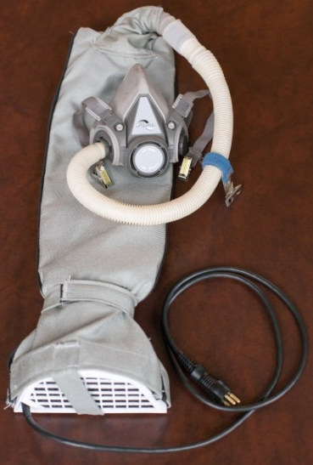
The Purifier Options:
1) Mask Strap (can be either):
- Hat Clips
- Head Strap
2) Battery
Cap Light (Wheat) Nicad (3M) Lithium Ion
Weight 1.4 lbs 1.8 lbs 0.5 lbs
Area 28 in³ 33 in³ 6 in³

Slide 14
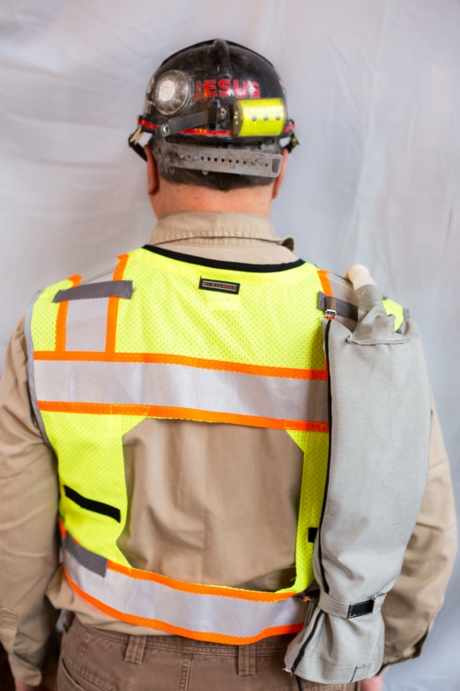
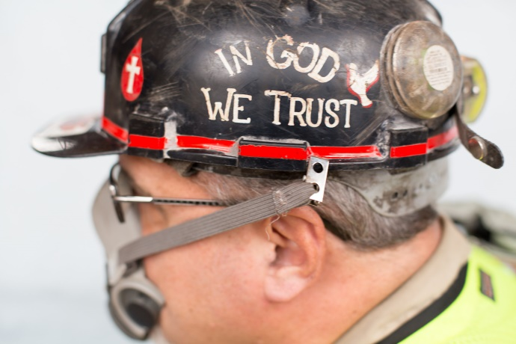
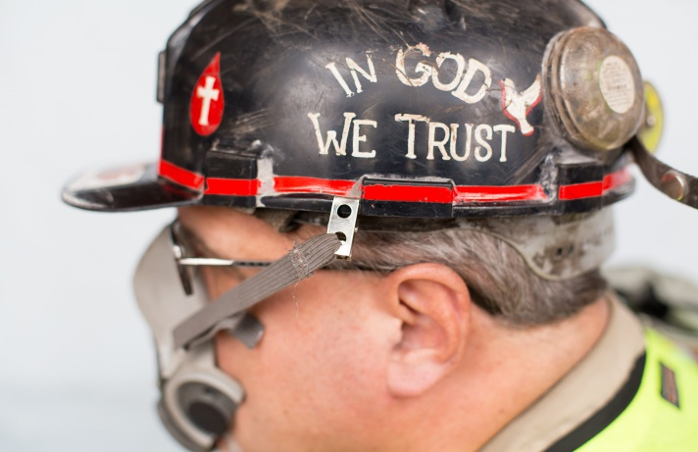
The Purifier:
Donning Procedure:
1) Filter bag is set-up on the vest’s back right
shoulder. It can be moved to the right front
or left back. If it is moved to the left back, the
flexible hose on the face mask should also be
swapped to the other side.
2) When securing the face mask, the hat clips should be positioned above the
ear on the hat edge.
Correct –
Behind Ear
Incorrect –
Front of Ear

Slide 15
The Purifier:
Donning Procedure:
3) Aggressive side of the clip should be on the
outside hat edge. The smooth side of the clip
goes on the inside of the hat. An optional
headband is also available.
4) The face mask should be custom adjusted to
feed the airflow to the operator’s nose. The
correct strap adjustment will provide a loose
fit, small amount of eye glass air sweep, and
voice recognition.
5) Flexible tubing can be shortened by 3” if the
extension is removed.

Slide 16
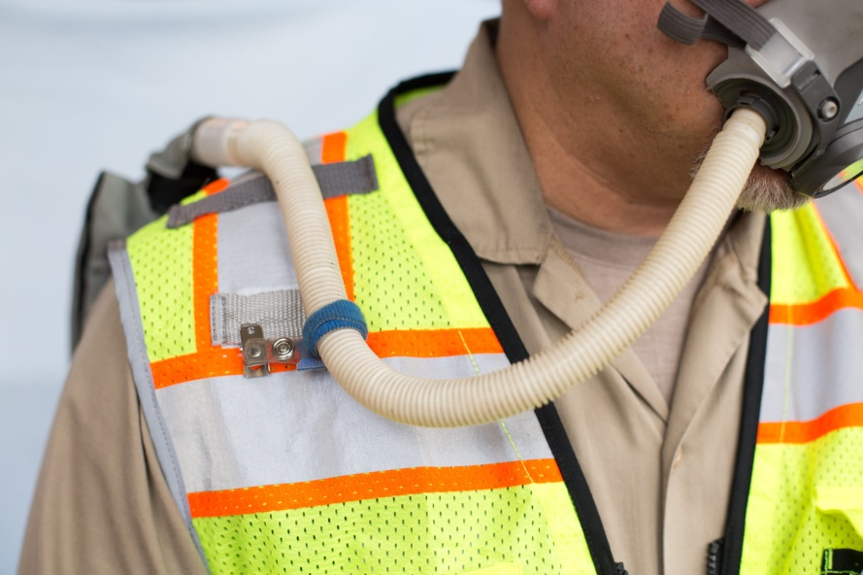
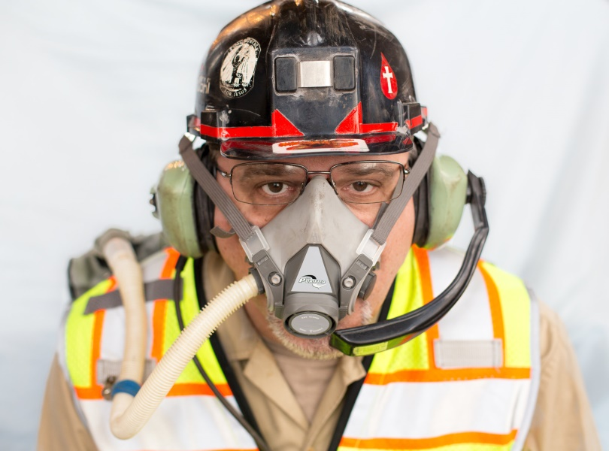
The Purifier:
Donning Procedure:
5) The tubing clip should be adjusted on the flex tubing in location to fit the
individual and ensure no flex tubing interference or restrictions.
6) Hearing protection/radio mouth piece
can also be used with the purifier.

Slide 17
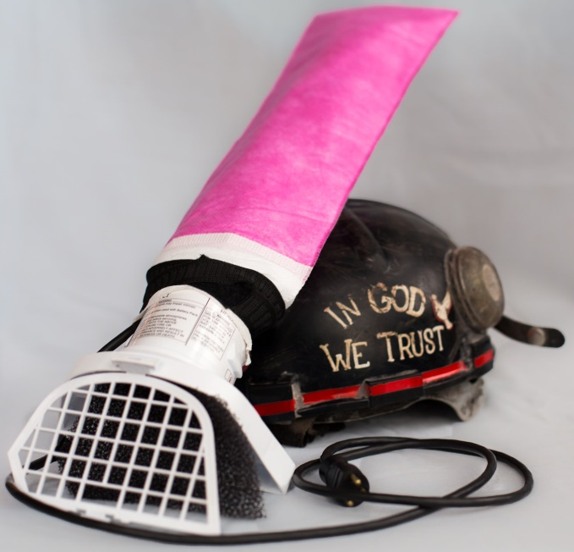
The Purifier:
Maintenance Tips:
1) Face mask should be thoroughly washed at least weekly and disinfectant wipes
used daily. When mask is not in use, it should be bagged.
2) Primary filter should be washed or replaced weekly or when obvious build-up can
be seen.
3) Secondary filter can be blown out to extend life.
It should be changed between 10 and 100 hours
of service (condition dependent).
4) When the secondary filter is changed, the flexible
tube inlet needs to be on the topside of the filter.
5) An air flow test should be used periodically to test
the pump and filter flow rates. The test disc and
instructions are included with The Purifier.
Secondary
Primary

Slide 18
The Purifier:
Miscellaneous Notes:
1) All electrical components (pump, cord (2), battery) have MSHA certifications.
2) Trials have been completed across 8 industries and within 12 companies. Many
suggestions have been incorporated. Testimonials are available upon request.
3) NIOSH certification should be easily achieved once mass production is started.
4) Upgrades to the electrical components are being developed and will be submitted
to MSHA. Considerable cost savings are expected.
5) Applications not needing MSHA permissibility approval can immediately save
+$450/unit with alternate battery sources (industrial, construction, disposal,
chemical, medical and fire fighters applications).
6) Used correctly, The Purifier will GREATLY reduce an individual’s respirable dust
intake.
Let’s help our industry eradicate ‘Black Lung and Silicocis.’

Slide 19
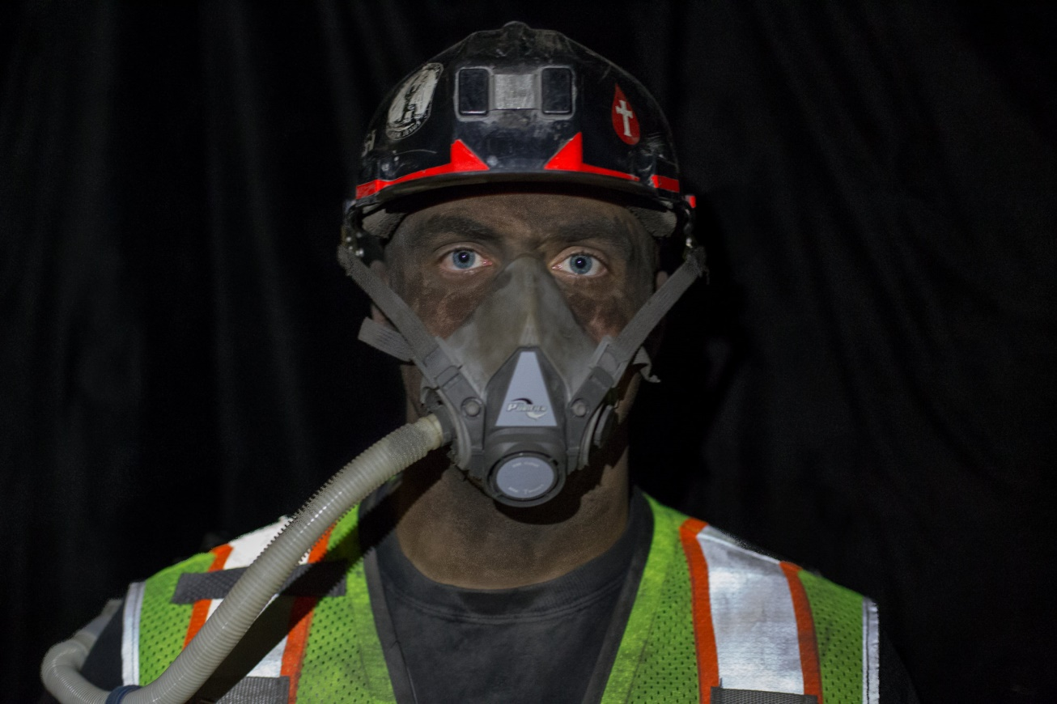
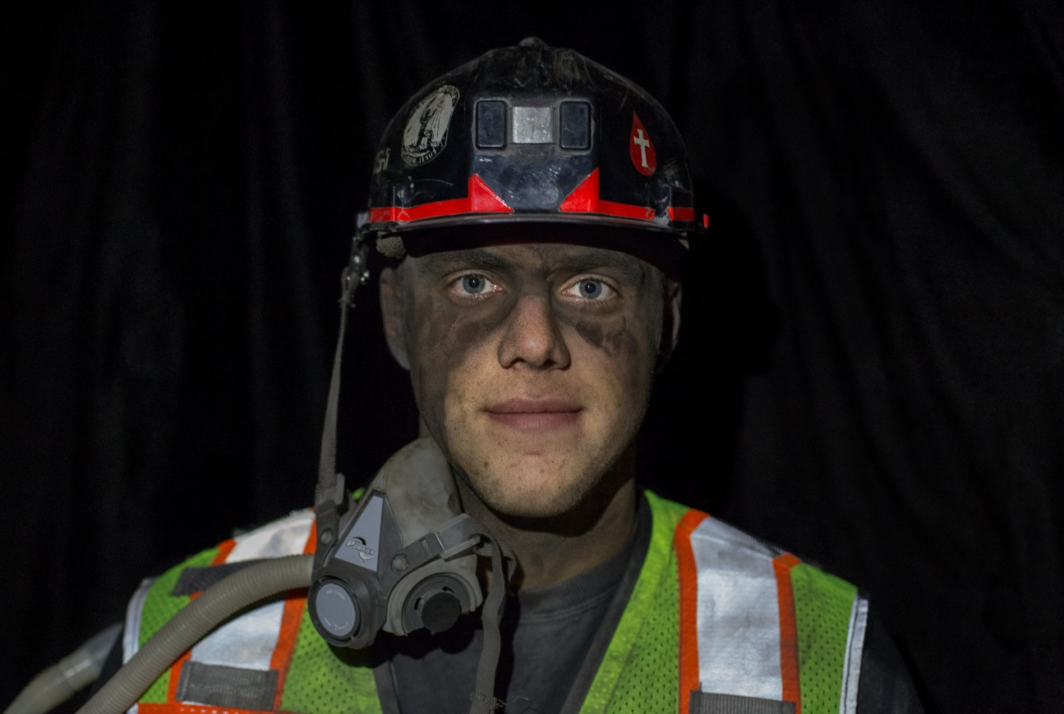
We have a choice in how to proceed . . .
Thank you for
Investing in our Future
‘ The Purifier Protects’

